Slide 1


Azure Cognitive Search Reference Architecture
Rodrigo Souza
Sr Data Scientist
Microsoft AI
/in/rodrigossz
Notes:
Add company logo
Make introduction, build credibility
Explain what you will talk about
Inquire about customer/audience’s definition of success for this engagement

Slide 2
Azure AI
a
b
AI apps & agents
Knowledge mining
Machine learning
Azure Cognitive Search
Form Recognizer

Slide 3




























Evolution of application search
Eiffel Tower
famous tower in Paris
Eiffel Tower
Eiffel Tower
Keyword search
Contextual search
Cognitive search

Slide 4
Knowledge mining scenarios
Auditing and compliance
Digital asset management
Technical content review
Process management
Customer feedback analytics
Catalog search
Azure Cognitive Search: Web-like search experience on top of you data

Slide 5
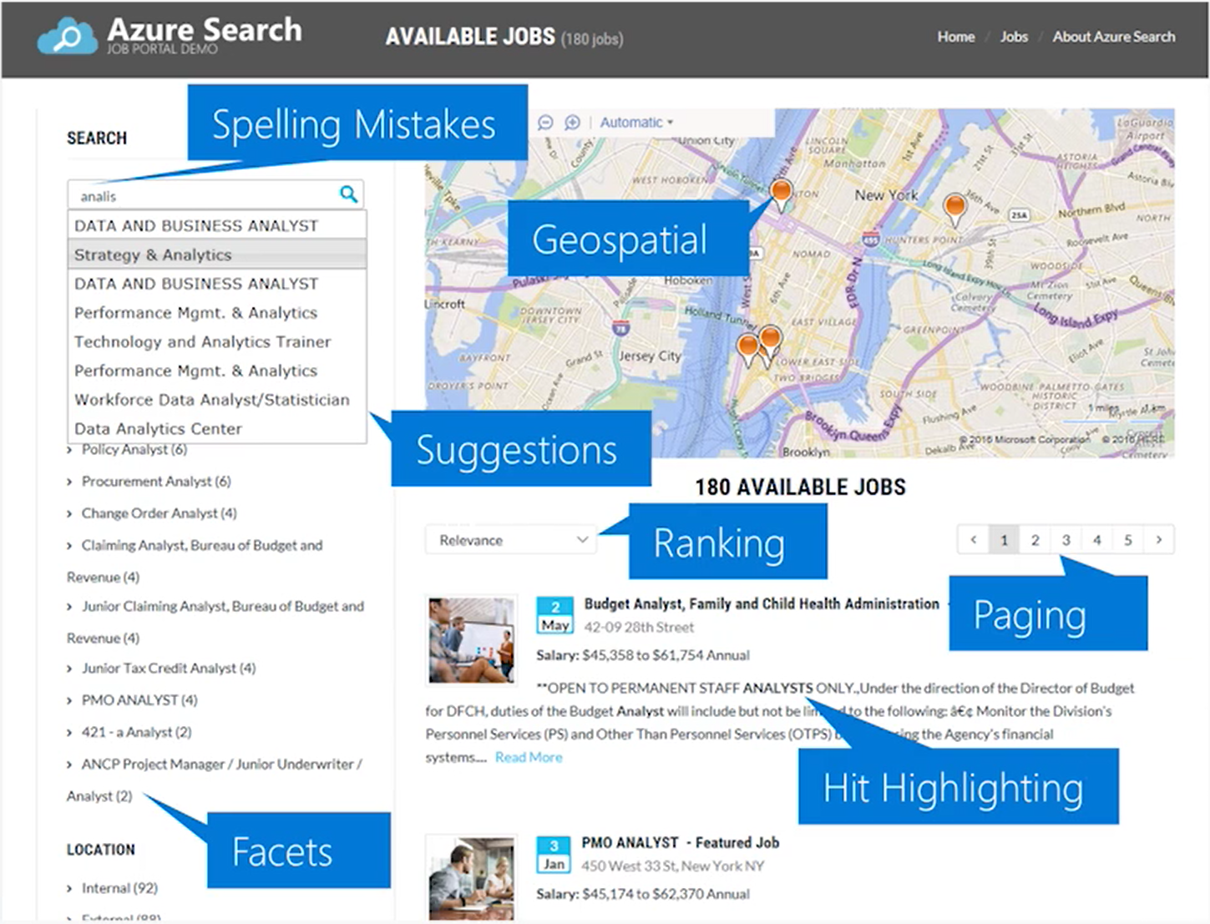
Azure Cognitive Search

Slide 6


Azure Cognitive Search – Reference Architecture
Ingest
Enrich
Explore
Built-In Cognitive skills
Examples
Azure Functions Custom skills
Examples
Web App
Images
Key phrase
extraction
Named entity extraction
Dates Extractor
CSV Lookup
Search Index
Bot
Language detection
Automatic translation
PDFs
Knowledge Store
Power BI
AML

Slide 7
Thank you!
Rodrigo Souza
Sr Data Scientist
Microsoft AI
/in/rodrigossz

